Slide 1
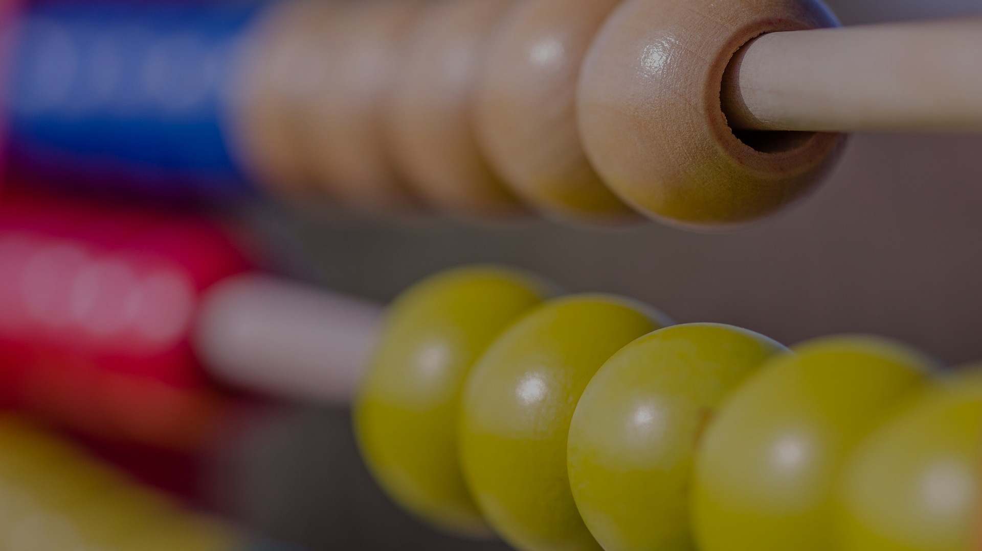
theoryofknowledge.net CLASSIC TOK Lesson MATH 3B
MATHEMATICS
METHODS & TOOLS (IMAGINATION)
I can explain how mathematics is “a sense that allows us to perceive realities which would be otherwise intangible to us”
Notes:
Key TOK terms appear in a red font

Slide 2
Starter
What was Sofya Kovalevskaya’s assertion about mathematics in our first lesson on this AOK? (Clue - ‘imagination’)
“Many who have had an opportunity of knowing any more about mathematics confuse it with arithmetic, and consider it an arid science. In reality, however, it is a science which requires a great amount of imagination.”

Slide 3
Pair, share
Has our mathematical journey so far confirmed or contradicted Sofya Kovalevskaya’s view?
Discuss with a partner, reach a conclusion, and then talk to another pair. Be ready to summarize what their response is.

Slide 4
“A world of progress and adventure and emotion.”
In pairs, access the interview with French mathematician Cédric Villani. Don’t read the article, instead…
…do a word search for the methods and concepts in this document.
what role does Villani say they play in the production of mathematical knowledge? How might this contradict common assumptions about the methods used by mathematicians?
which of these do you find the most surprising? Do Villani’s ideas confirm or contradict what our other experts have said about imagination and mathematics?
Notes:
Students can either do the whole thing in pairs, or work on a single method/concept and then collate responses.

Slide 5
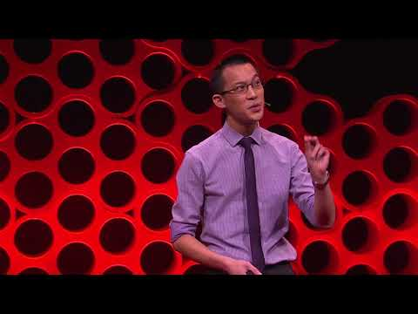
“Combining insight with imagination”
Watch Eddie Woo’s talk from 5.10.
What was his original opinion of mathematics - and how did this change?
What examples does he give of ‘mathematical realities’, and how can mathematics be used to understand them?
What are the consequences of assuming we’re incapable of doing mathematics?
What do artists and mathematicians share?
Do you agree that mathematics is like an extra sense?

Slide 6
Links to the TOK exhibition
Related exhibition prompt What role does imagination play in producing knowledge about the world? (IAP-30)
Refer to the ideas from this lesson to answer this question.
For example, think about the role of imagination in representing numbers (and the world) in different ways.
Which objects could help to illustrate your answer?
Notes:
Optional slide, if you want to help students to take ownership of the IA prompts (IAPs) for the TOK exhibition

Slide 7
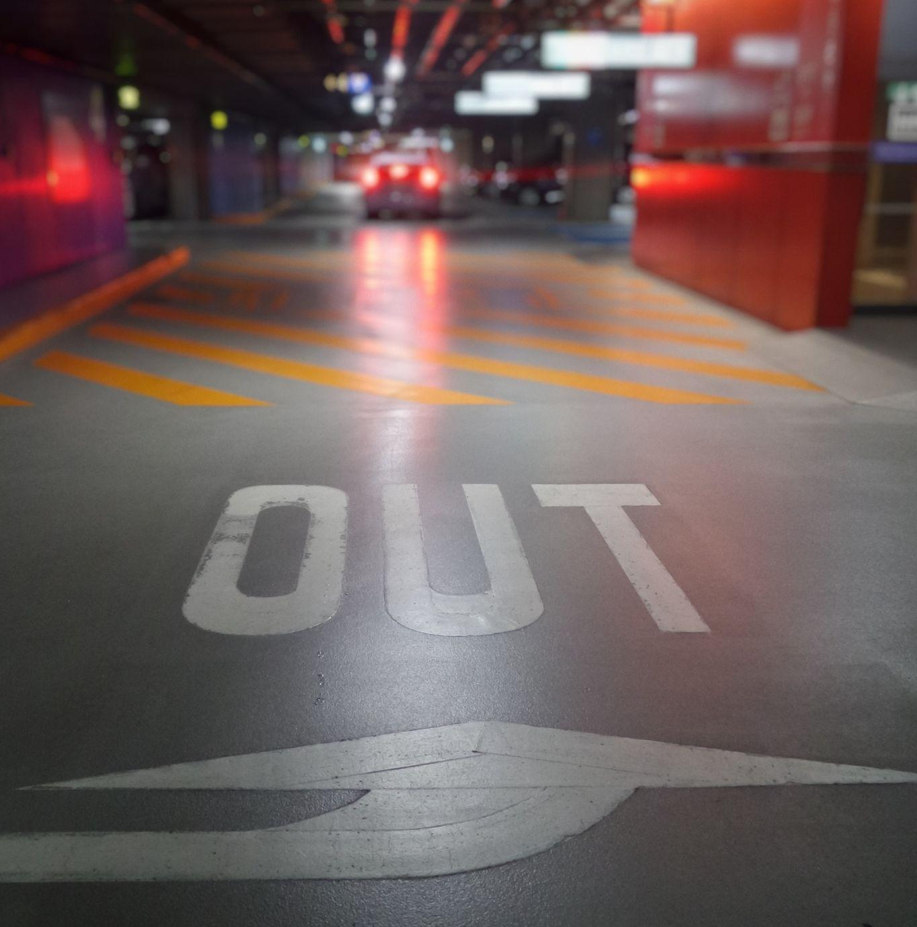
Overall, how crucial would you say imagination is to the production of mathematical knowledge?
Support your ideas with at least one example from the lesson.

Slide 8
EXPLORE FURTHER
Check out the TOK mini-lessons for mathematics, offering short media-driven lessons that can be delivered within both TOK and non-TOK classrooms.
Research the methods and tools of mathematics in more detail via our exploration points document. Students can use this resource to support arguments in their essays and exhibitions.
Link mathematics to the key concepts of TOK, meet influential mathematical thinkers in knowledge heroes, and find more issues related to this area of knowledge in investigating issues.

